Slide 1
Secure Cloud Manufacturing
Final Presentation
April 24th, 2019

Slide 2




Team Members
Andrew Ramacher
(lead)
Sameer S
(code manager)
Youwen Zhu
(documentation manager)
Serafina Kamp
(team scribe)
Team Meeting : Thursday 5:30 pm to 7 pm, 2733 BBB

Slide 3
Term Goals
Cloud
Build/improve data collection framework (Sameer, Serafina)
Security
Build anomaly/intrusion app that utilizes correlation between physical machine states and network traffic
Complete data pipeline for real time formatted data (Andrew)
Improve Machine Learning Algorithm (Youwen)

Slide 4
Data Collection framework (Sameer S)
Motivation
Improve upon previous semester’s data extraction tool by making a standardized library
Make data more accessible and make tools for extraction easier to integrate into projects
Approach
Develop library for remote data extraction that can be used in Java/Python and can be easily modified
Develop methods to retrieve data from AWS

Slide 5
Data Collection framework (Sameer S)
Final Progress
Developed a library that allows users to extract data remotely
Developed multiple methods for retrieving the data (Python, Java, UI tool)
Time analysis for sending different amount of data using the library
Documentation for setting up AWS for future semesters
Impact & Future Work
Applications are easier to develop
Applications have more flexibility in how and where they are run
Library easily modifiable for future development

Slide 6
Data Collection framework (Sameer S)
Test Bed Computer
Remote Application
gRPC
client
Local API
gRPC server
OPC Server

Slide 7
Data Collection framework (Sameer S)
gRPC Library
gRPC (google’s Remote Procedural Call) library is being used as it is fast, safe, and reliable
Consists of server and client. The Client retrieves data and can be used across different languages (Java, Python, and a simple UI tool).
There are two forms you can receive the data in: full and “lite”. Full just retrieves all the data from the OPC server and lite simply gives tag data.
Mimics local API’s methods for easier integration
LOCAL SERVER
getTag
getGroups
getTagsInGroup
getMultipleTags
“lite” functions
setTag
watchState
REMOTE CLIENT
getTag
getGroups
getTagsInGroup
getMultipleTags
“lite” functions
setTag
watchState

Slide 8
3
2
1
OPC Server
Local API’s
gRPC Server
gRPC Client
4
5
6
Method used | Communication time between Client and Server (ms) (Steps 1 & 6) | Elapsed time between request and response (ms) (All steps)
getExistingGroups | Avg = 11.60ms, StdDev = 4.6ms | Avg =42.14ms, StdDev = 5.9ms
getAvailableTagsInGroup | Avg = 10.18ms, StdDev = 3.34ms | Avg = 4598.49ms, StdDev = 35.89ms
getTag | Avg = 10.84ms, StdDev = 4.08ms | Avg = 61.07ms, StdDev = 9.44ms
NOTE: Latencies are bottlenecked by the OPC server which is somewhat volatile

Slide 9
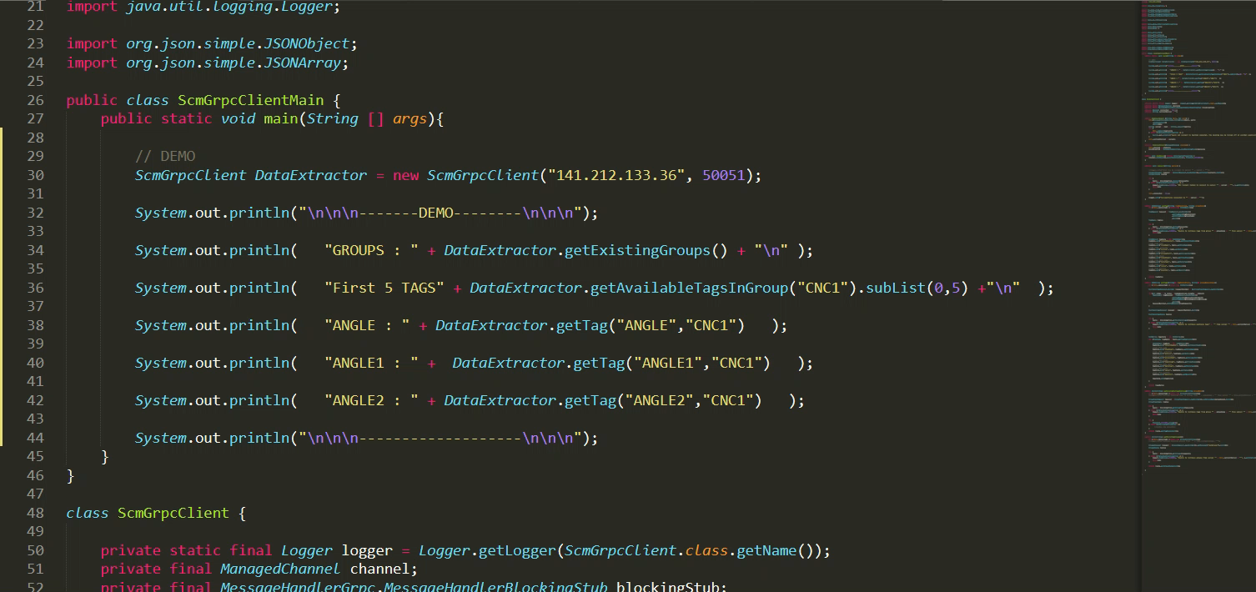
Data Collection framework (Sameer S)

Slide 10
Data Collection framework (Sameer S)
Impact
Applications that need to extract data are easier to develop and have more flexibility in how and where they are run
The library can be easily changed to accommodate any future changes
The local API’s and the gRPC library can be used interchangeably so there won’t be any overheard when switching between collecting data remotely and locally

Slide 11
Data Collection framework (Sameer S)
Future Work
Using AWS for a specific purpose
Transfer “heavy lifting” for remote data extraction to parts of the process closer to the OPC server
Fix errors with streaming data
If latency or usability is a concern, then other methods such as a REST api should be tested out as an alternative
General upkeep and adding in more functions if needed

Slide 12
Data Extraction and Processing (Serafina)
Motivation
To make data from the testbed easily accessible to other members of the team and outside clients.
Approach
Utilize functions from JEasyOpc to pull and write data from/to the OPC server
Return data in JSON format so it can be used language-independently

Slide 13
Data Extraction and Processing (Serafina)
Final Progress
3 APIs handling data extraction/processing
getAllInfo, setAllInfo, whenDataChange
Documentation stored on shared drive
Functions include: getTag, getTags, getExistingGroups, getAvailableTagsInGroup, writeTag, checkDataChange – All have been tested successfully
Impact & Future Work
Collaboration with Modelling and Simulation sub team
Kexin and Hao use getTag in their digital twin models, could be useful in future projects where tag values are needed
Potentially work on more data analytic functions in the future (add to whenDataChange)

Slide 14
Data Flow Through APIs
whenDataChange API
String of value change
gRPC server
Clients
JSON data
getInfo API
setInfo API
JOPC
New tag (OPC item)
OPC Server
Testbed Data (PLC)

Slide 15
Time Analysis of Functions
Function | Number of Times Called | Average Time | Standard Deviation
getTag | 500 | 66.34 ms | 3.67 ms
getExistingGroups | 500 | 305.29 ms | 1.00 ms

Slide 16
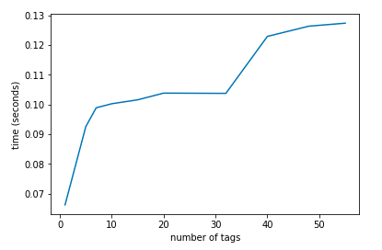
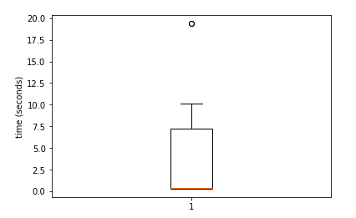
Time Graphs
getTags
getAvailableTagsInGroup
Average: 2.996 sec
Mode: 0.307 sec

Slide 17
Data Pipeline and Formatting (Andrew)
Motivation
Visualization
ML Algorithm
Anomaly app needs real time data from the testbed
APP
Decision
Formatted inputs
HTTP Server
Approach
Create database for transferring network traffic
Add functionality for sending and formatting network traffic in HTTP server
Test full pipeline in real time
Machine Status
Network Traffic
Northbound Interface

Slide 18
Frontend Visualization (Andrew)
Final Progress
Full pipeline complete with demo (except ML output -> frontend)
Real time testing completed and effective sample rate chosen
Real time states detected!
Impact & Future Work
Complete path from ML output to frontend (use existing parts)
Framework can be used for other apps running on testbed
Make entire app run from a single executable

Slide 19
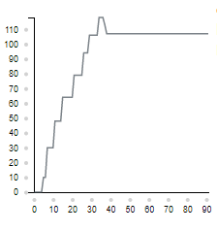
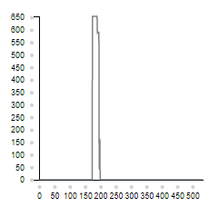
Graphs of # packets extracted
1 sec intervals
0.5 sec intervals
# Packets
# Packets
# Intervals
# Intervals

Slide 20
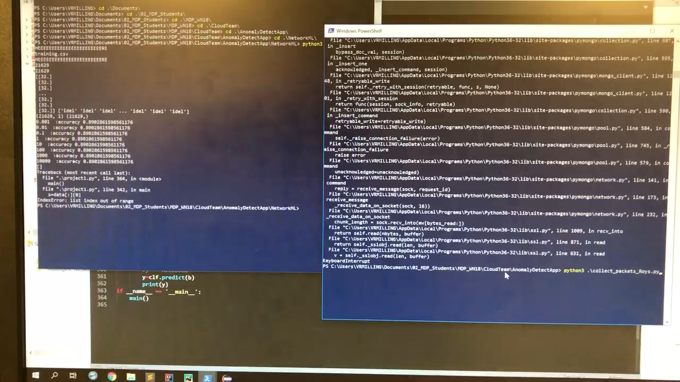
DEMO

Slide 21
Machine Status Verification (Youwen)
Motivation
Find out whether there is an efficient Machine Learning Algorithm to classify Machine Status with network traffic as feature data
Use machine learning algorithm to verify whether CNC is in a specific state
Recognize some typical anomalies by analyzing the network traffic
Display testbed data
Approach
Determine features in the network packets that are related to the status of machine
Build a machine learning model based on the different features when machines are in different states

Slide 22
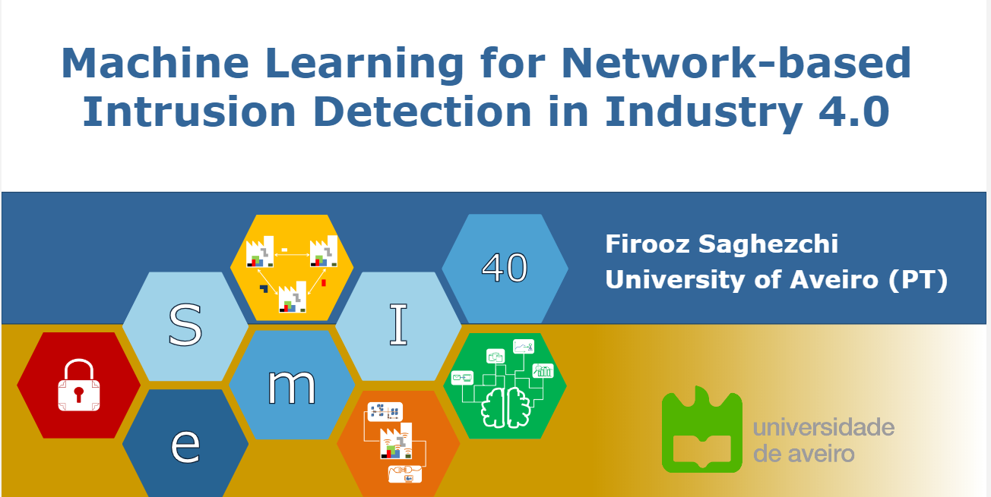
Background
There are not many paper on the topic of Network based detection.
The general idea is: first analyze the network packets from individual devices to see whether the data can reflect the machine state and whether the state is “correct”(in our expectation)
Then we can also compare the packets from different devices to see whether they match the same state

Slide 23

Background
There are not many paper on the topic of Network based detection.
I read the paper on topic: Hierarchical Monitoring Intrusion Detection System based on network traffic
It uses statistics data of hierarchical level to detect network intrusion
In my project, I focus on network for individual device instead of the statistics data for the whole system

Slide 24
Machine Status Verification (Youwen)
Final Progress
Figure out the feature that correspond to the status change of CNC
Build a multi-label machine learning classifier that can determine the most possible state of CNC
Build a binary machine learning classifier that can verify the Machine Status given the result from Digital Twins
Impact & Future Work
Explore more useful feature in the network packet, which can reflect more information about the devices
Try to analyze other devices like robot arm
Build a more complete model for the classifier

Slide 25
Machine Status Verification (Youwen)
Step 1: do experiments to find out the feature that corresponding the status change of CNC
Packet： from 192.168.1.120(plc of CNC2) to 239.192.15.255(multicast for CNC2)
X: timestamp (second)
Y: Data segment (transformed to int)

Slide 26
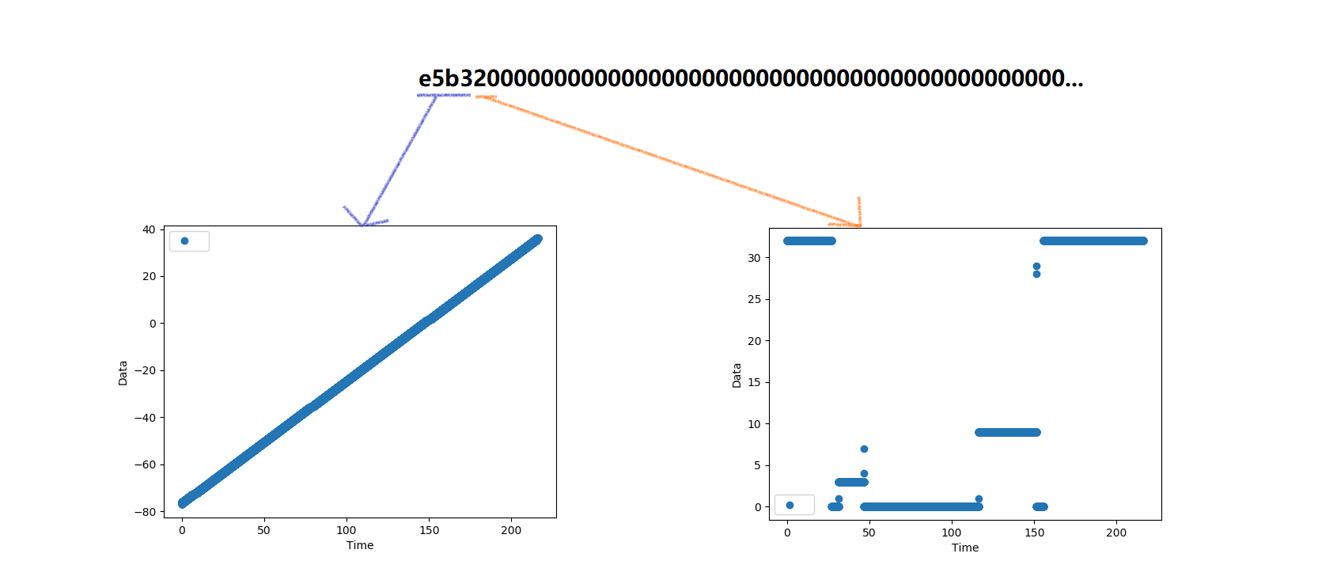
Packet： from 192.168.1.120(plc of CNC2) to 239.192.15.255(multicast for CNC2)
X: timestamp (second)
Y: Data segment (transformed to int)
Left(first 2B): heartbeats encoding in little endian(signed)
Right(the third Byte): corresponding to machine status

Slide 27
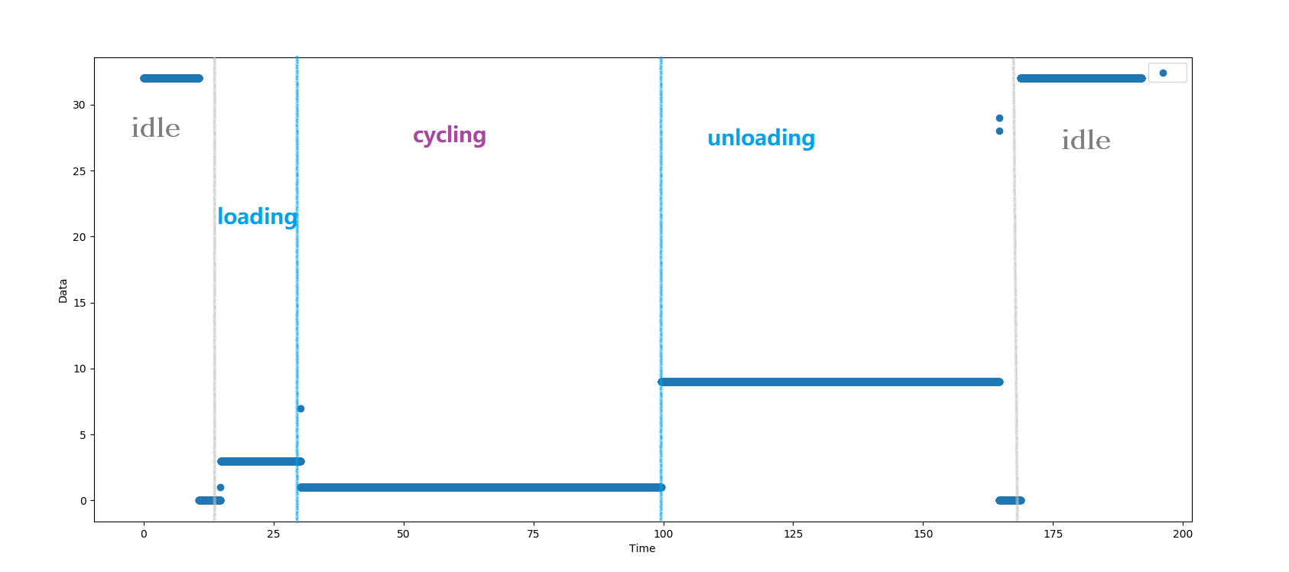
Analyze packages deeper

Slide 28
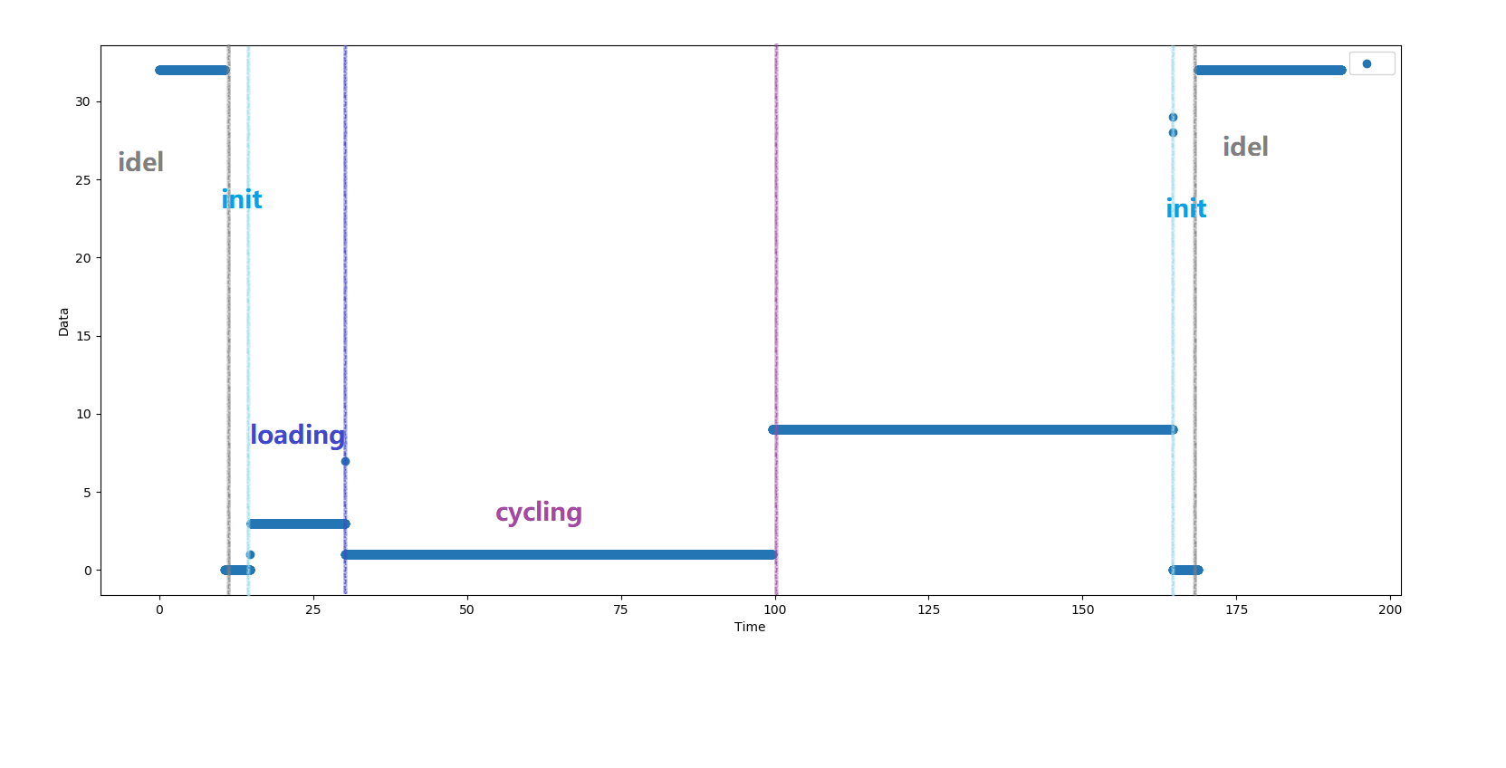
For the classifying purpose

Slide 29
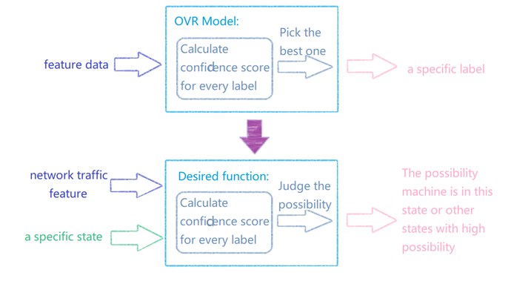
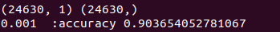
Machine Status Verification - Youwen
Build machine learning classifier that can determine the most possible state of CNC
OVR model
5 fold cross-validation

Slide 30
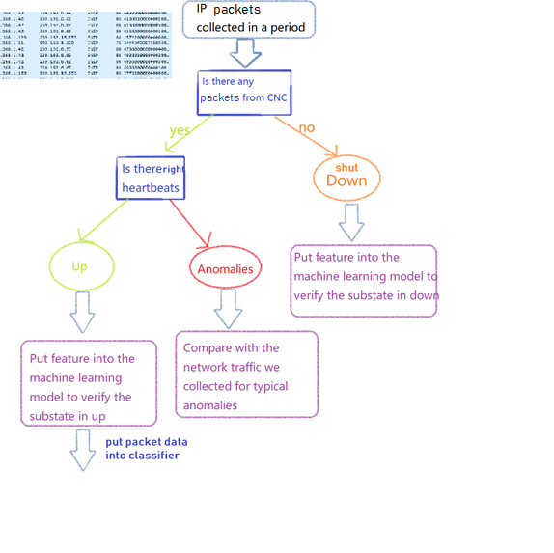

Slide 31
Difference with Digital Twins
 | state classifier based on network traffic | digital twin
History | use current data to classify current state | use current state to move to next state
Data | based a segment in packets | examines several tags
Accuracy | may have some error because ML algorithm | Basically accurate if no anomalies occur

Slide 32
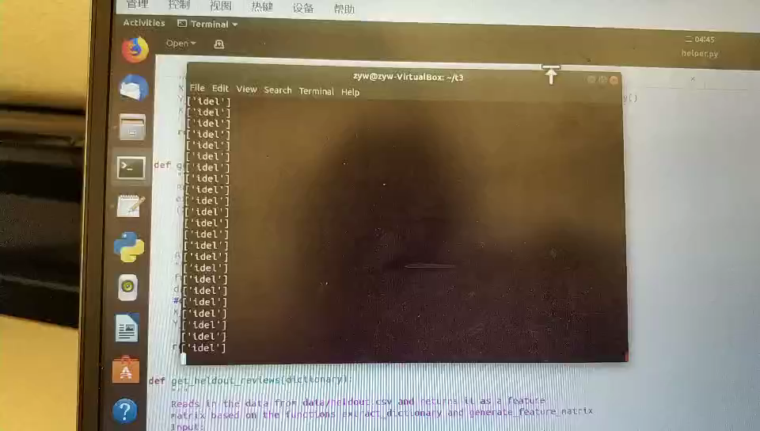
DEMO with local data

Slide 33
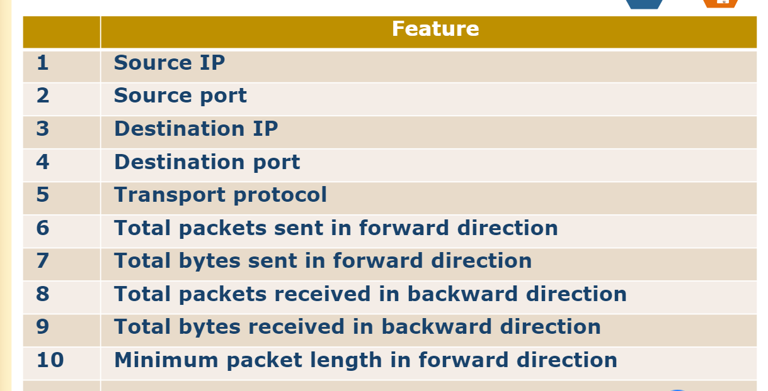
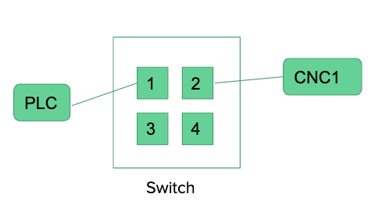
Future work
Build a machine learning algorithm to find the useful feature corresponding to machine status automatically
Learn more about CIP, try to understand the physical meaning in the network packet
Add more packets from PLC and Robotic Arm or other devices in the future, which may help get a overall view on the whole system

Slide 34
Thank You

Slide 35
References
[1] Balta, E. C., Tilbury, D. M., Barton, K. A Centralized Framework for System-Level Control and Management of Additive Manufacturing Fleets. Manuscript in preparation, University of Michigan.
[2] Cummings, I. T., Bax, M. E., Fuller, I. J., Wachtor, A. J., & Bernardin, J. D. (2017). A Framework for Additive Manufacturing Process Monitoring & Control. In Topics in Modal Analysis & Testing, Volume 10 (pp. 137-146). Springer, Cham.

